Slide 1
Testing the Structure of Exotic Nuclei via Coulomb Excitation of Radioactive Ion Beams at Intermediate Energies
T. Glasmacher
Domenichetti Lorenzo, 19-2-2021, Nuclear Physics

Slide 2
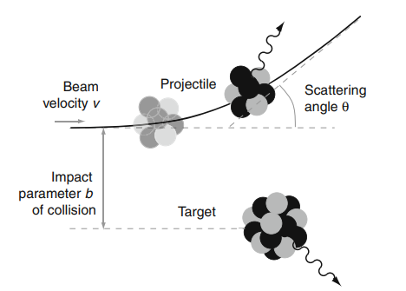
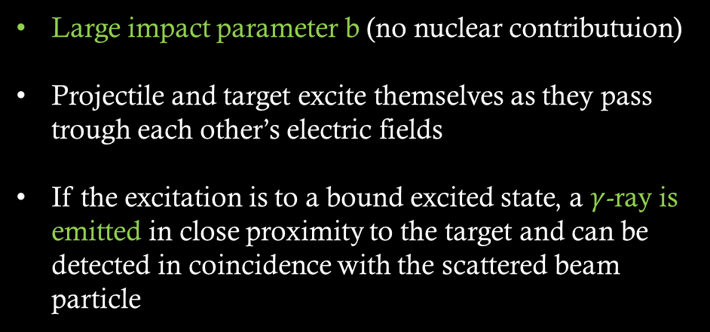
Coulomb Excitation
Large impact parameter b (no nuclear contributuion)
Projectile and target excite themselves as they pass trough each other’s electric fields
If the excitation is to a bound excited state, a $γ$-ray is emitted in close proximity to the target and can be detected in coincidence with the scattered beam particle
Domenichetti Lorenzo, 19-2-2021, Nuclear Physics
Notes:
Se vogliamo utilizzare ioni radioattivi, dovremo utilizzare questi come proiettili, data la loro breve vita media!

Slide 3

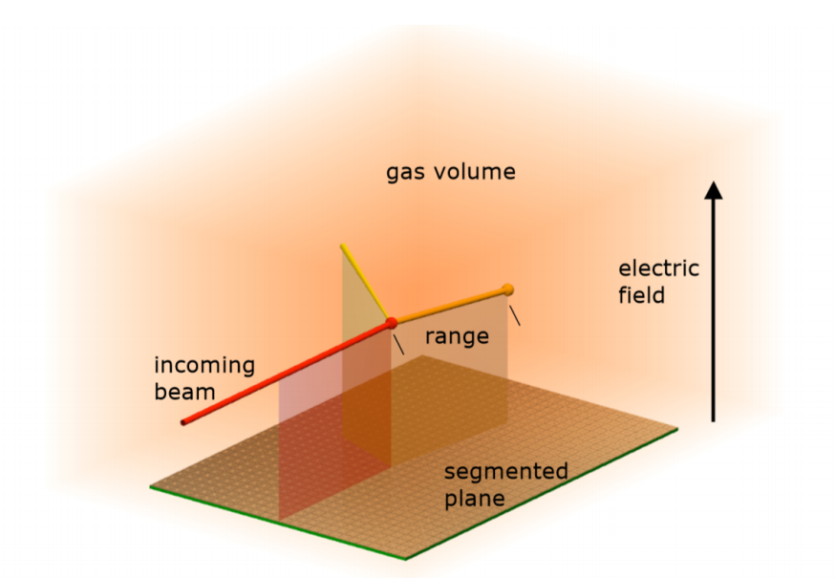
Coulex with RIBs
For enriching the knowledge on nuclei, many facilities dedicated to the production of radioactive nuclei are today active or actually under developement
Experimenters have to develop new and efficient techniques that can measure observables with the available beam rates
In this presentation we review the status of Coulomb excitation at intermediate energies.
This technique allows measurement up to orders of particle/s!
Domenichetti Lorenzo, 19-2-2021, Nuclear Physics
Notes:
Production of beams far from stability decreases by orders of magnitude with farer nuclei from stability. And we can not increase the experiment beam time by orders of magnitude!

Slide 4

History of Coulex in a nutshell
1950s:
Studies of electromagnetic transition strenghts with stable beams and targets. Typically, energies were below the Coulomb barrier.
1991, @University of Notre Dame:
⁸Li beam off a ^{nat}Ni (1.1 mg/cm²) at a beam energy of 14.6 MeV.
Excited ⁸Li nuclei were detected in a position-sensitive silicon $∆$E/E detector, with an energy uncertainty of 400-500 keV.
1992, @JAERI:
⁷⁶Kr 237MeV beam off a ²⁰⁸Pb target (2.0 mg/cm2).
Deexcitation $γ$-rays (2+ g.s.) were detected in four germanium detectors.
Domenichetti Lorenzo, 19-2-2021, Nuclear Physics
Notes:
Production of beams far from stability decreases by orders of magnitude with farer nuclei from stability. And we can not increase the experiment beam time by orders of magnitude!

Slide 5
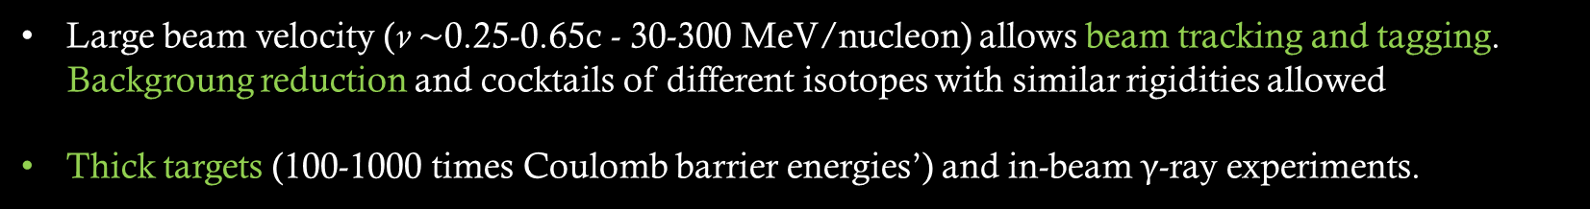

Why intermediate energies?
Large beam velocity (v $\sim$0.25-0.65c - 30-300 MeV/nucleon) allows beam tracking and tagging.
Backgroung reduction and cocktails of different isotopes with similar rigidities allowed
Thick targets (100-1000 times Coulomb barrier energies’) and in-beam $γ$-ray experiments.
$$N_{reactions}=\frac{N_{γ}}{ε}=σ {×N}_{target} {×N}_{beam}$$
Domenichetti Lorenzo, 19-2-2021, Nuclear Physics
Notes:
Explain the formula with all the terms!

Slide 6
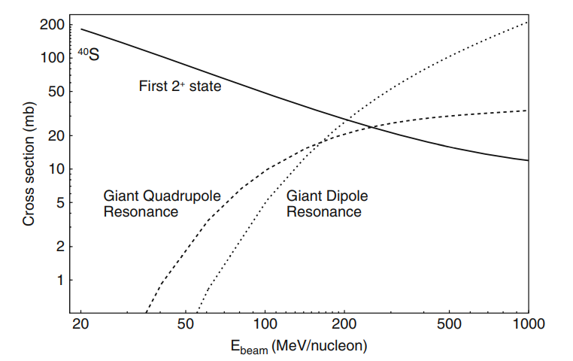
Coulomb Excitation cross section
Ex: ⁴⁰S beam on gold target
Cross sections are shown for a low-lying collective 2+ state, the giant quadrupole resonance, and for the giant dipole resonance
In this case, low energies beams are better suited to study low lying collective states
Domenichetti Lorenzo, 19-2-2021, Nuclear Physics

Slide 7
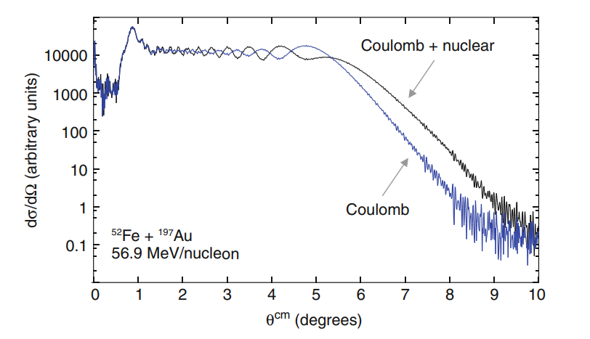
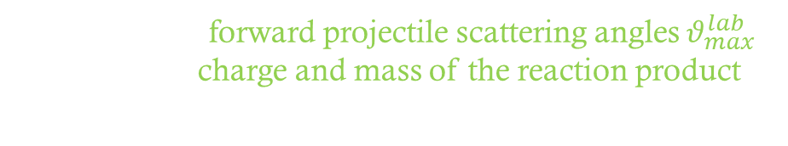
How to exclude nuclear contribution?
Requiring forward projectile scattering angles $θ_{max}^{lab}$
Ensuring charge and mass of the reaction product are identical to that of the projectile.
The optical model calculation* in the figure shows the domincance of the Coulomb excitation cross section over nuclear contributions at small scattering angles.
*Optical model parameters from the ⁴⁰Ar + ²⁰⁸Pb reaction at 41 MeV/nucleon were used to calculate the cross sections.
Domenichetti Lorenzo, 19-2-2021, Nuclear Physics

Slide 8
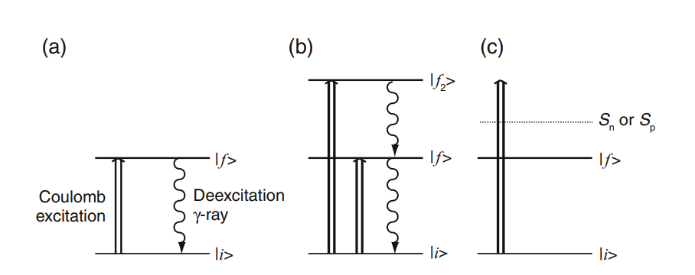
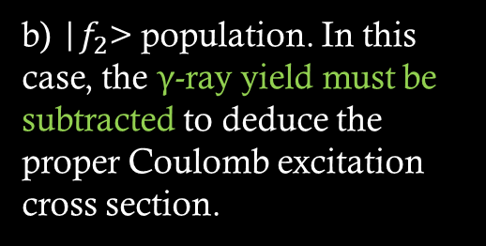

Multiple low-lying states population
a) Desidered process in which a nucleus in the g.s. in excited to the |$f$> state.
$γ$-ray yield proportional to cross section $σ_{i→f}$.
b) |$f_{2}$> population. In this case, the $γ$-ray yield must be subtracted to deduce the proper Coulomb excitation cross section.
c) Excitations above the particle separation threshold lead to the breakup of the projectile. They are excluded from the analysis.
Domenichetti Lorenzo, 19-2-2021, Nuclear Physics

Slide 9
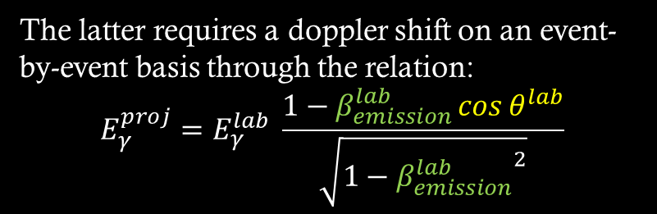




$γ$-ray spectrum correction
Detectors: limited solid angle - energy dependent efficiency - Doppler shift of the projectile $γ$-rays
Noise reduction from coincidences between $γ$-rays and projectile measurement
$E_{γ}^{lab}$spectrum
Two spectra
$E_{γ}^{proj}$spectrum
The latter requires a doppler shift on an event-by-event basis through the relation:
$$E_{γ}^{proj}=E_{γ}^{lab} \frac{1−β_{emission}^{lab}\cos{θ^{lab}}}{\sqrt{1−{β_{emission}^{lab}}^{2}}}$$
$θ^{lab}:$Angle between scattered projectile and $γ$-ray
$β_{emission}^{lab}$: Velocity of projectile at time of $γ$-ray emission (usually mid-target)
Domenichetti Lorenzo, 19-2-2021, Nuclear Physics

Slide 10
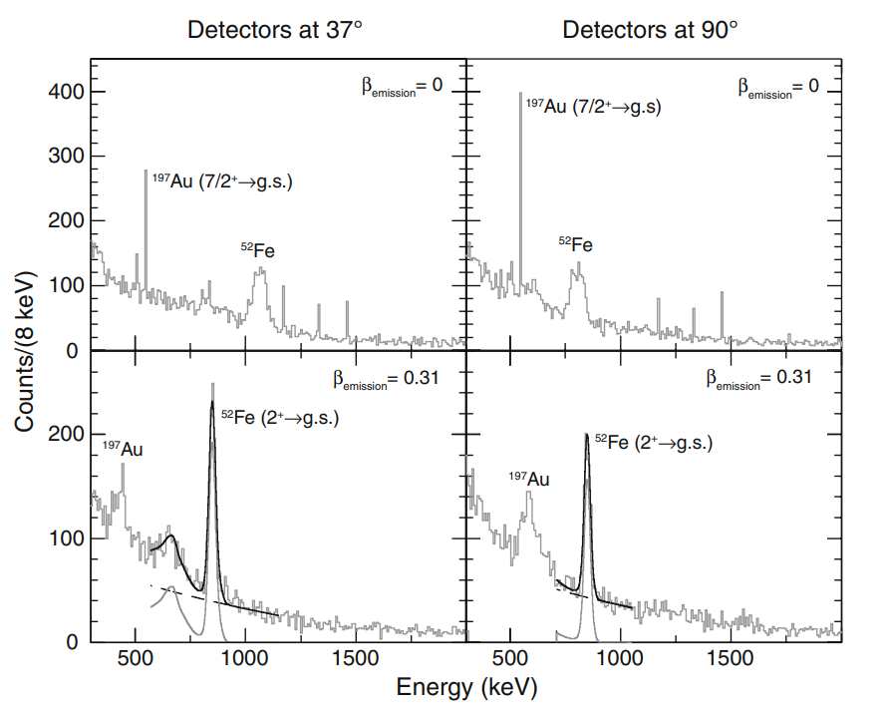
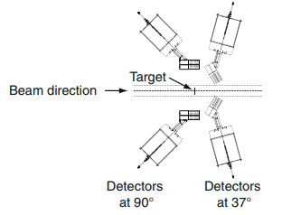
Examples of spectra
65.2 MeV/A ⁵²Fe on ¹⁹⁷Au (257.7 mg/cm²)
Lab
Lab
Experimental setup
Lab: sharp 7/2⁺ -> g.s. transition in the target
Broad photopeaks for proj. transitions
37° ⁵²Fe 849keV transition at higher energies
(com forward angle) and lower at 90° (backward)
Proj
Proj
Proj: sharp ⁵²Fe transitions, broad target ones
37° visible Compton edge photopeak
90° less pronounced: lower energy and thus lower Compton cross section
Simulated response functions + bkg
Domenichetti Lorenzo, 19-2-2021, Nuclear Physics

Slide 11



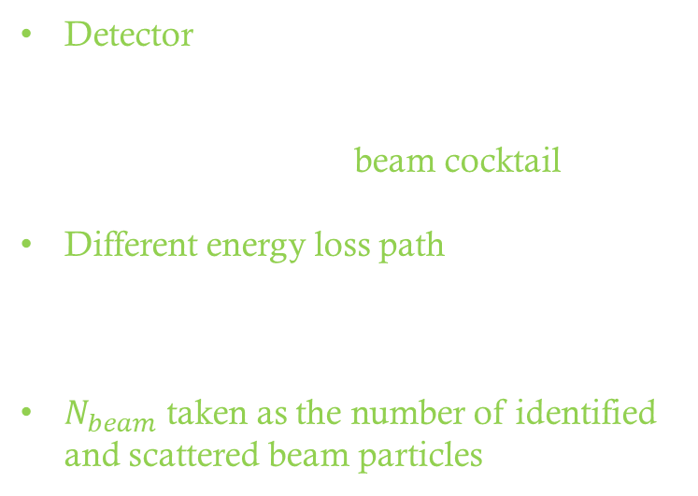

$$N_{reactions}=\frac{N_{γ}}{ε}=σ {×N}_{target} {×N}_{beam}$$
$$N_{beam}$$
$$N_{target}$$
Detector depends on beam rate, secondary beam purity and composition
L$ow beam rates→$ beam cocktail
Different energy loss path in order to identify particles not impinging on to the target
$N_{beam}$ taken as the number of identified and scattered beam particles
Thickness d and volume density $ρ$
Relative position to the $γ$-ray detectors for the Doppler reconstruction
Isotopic composition to check Coulomb excitation of the isotopes in the target
$γ$-ray from projectile and target not close to each other
Domenichetti Lorenzo, 19-2-2021, Nuclear Physics
Notes:
(ToF + silicon)
Numb of scattered particles if acceptance of the reaction detector is large (valid approx. if Coulomb elastic cross section is dominant over all others)

Slide 12


$N_{target}$consideration
$$N_{reactions}=\frac{N_{γ}}{ε}=σ {×N}_{target} {×N}_{beam}$$
Calculated from thickness d and volume density $ρ$ when foils are used
The target relative position to the $γ$-ray detectors must be known for the Doppler reconstruction
Knowledge of the isotopic composition is useful to determine the Coulomb excitation cross section of the isotopes in the target
Target are chosen such that $γ$-ray from projectile and target are not close to each other
Domenichetti Lorenzo, 19-2-2021, Nuclear Physics

Slide 13
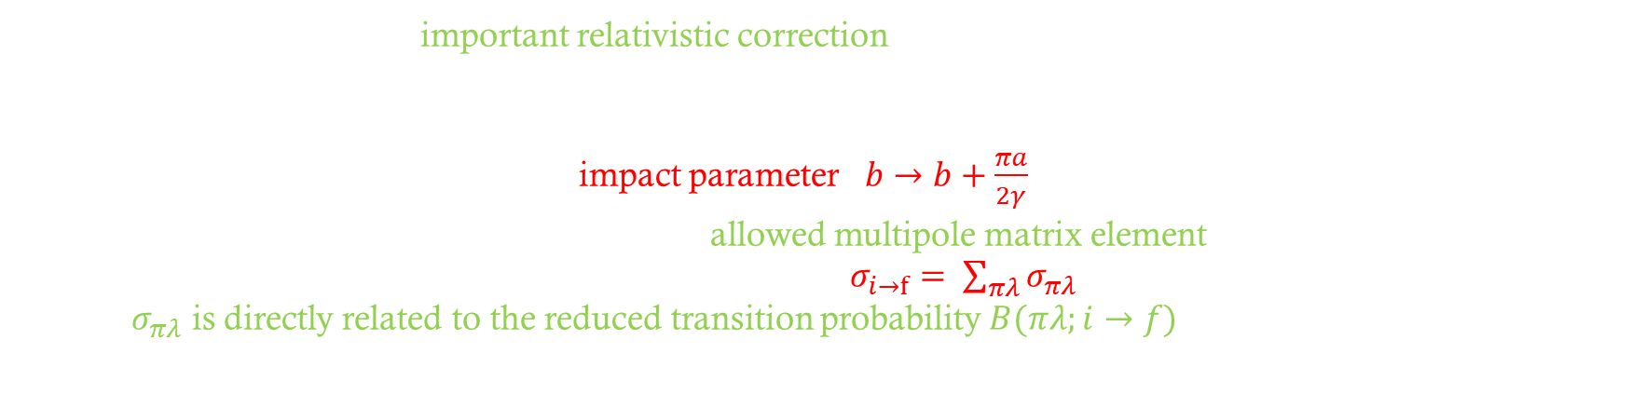
Theoretical approaches
Intermediate energies: still important relativistic correction
Winther and Alder – semi-classical solution (1979)
First order target recoil deviation $→$ impact parameter $b→b+\frac{πa}{2γ}$ $γ=\frac{1}{\sqrt{1−β^{2}} }$ $a=\frac{Z_{proj}Z_{t}e^{2}}{μβ^{2}c^{2}}$
Cross section decomposed into the sum of the allowed multipole matrix element characteristic of the electromagnetic decay of the nuclear state |f > to |i >: $σ_{i→f}= \sum_{πλ}{σ_{πλ}}$
Where $σ_{πλ}$ is directly related to the reduced transition probability $B(πλ;i→f)$
The Weizsacher-Williams method (1934) : Coulomb excitation process as the absorption of virtual photons produced by relativistically charged particles
Bertulani and collaborators : quantum theory leads to minor modifications.
(Significant in some cases*)
Domenichetti Lorenzo, 19-2-2021, Nuclear Physics

Slide 14
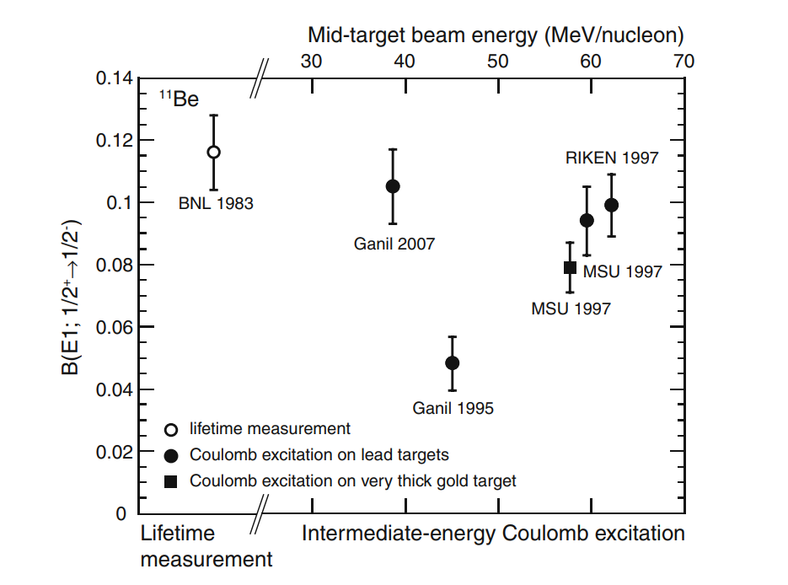
¹¹Be Neutron-Halo
1983: Lifetime measurement
1995: Coulomb Excitation
B(E1) from Winther and Alder method
2007: Coulomb Excitation
B(E1) from quantum mechanical description of Coulomb excitation with coupling to the continuum.
Domenichetti Lorenzo, 19-2-2021, Nuclear Physics
Notes:
11Be: only one excited state ½+ , gs ½-. From excitation cross section, one calculates the B(E1) from these two states.
Several approaches to modify the W&A theory in order to explain the result obtained. None of them managed to reproduce a compatible results wrt the BNL measurement
75% correction for photo absorption in the target (Au)

Slide 15
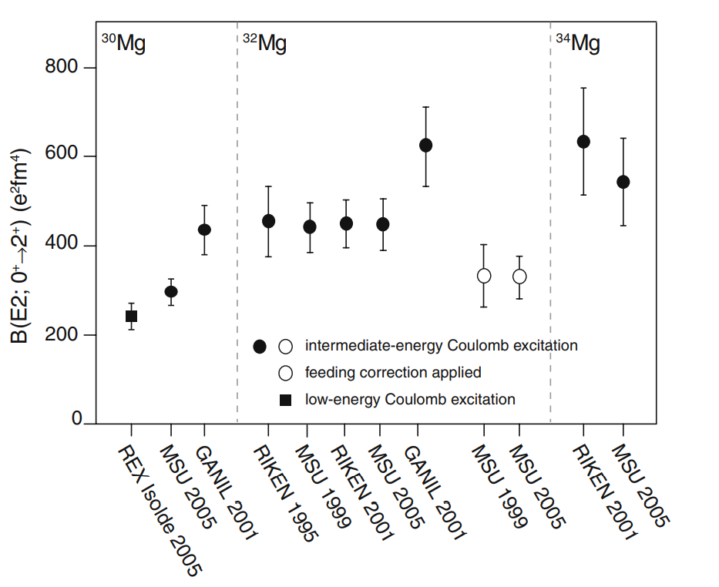
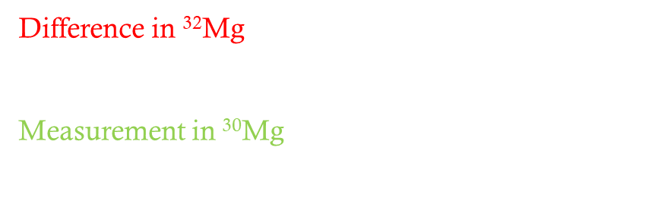
^{30,32,34}Mg Island of inversion
Experimental data understood with intruder configurations in ground and excited states
Difference in ³²Mg still not understood
GANIL result: very large deformation ($β$ = 0.61(3))*
Measurement in ³⁰Mg also not in agreement
MSU agrees with recent REX-isolde measurement
*rotational model interpretation
Domenichetti Lorenzo, 19-2-2021, Nuclear Physics
Notes:
IoI due to filling of vf7/2 orbital: strongly deformed states

Slide 16
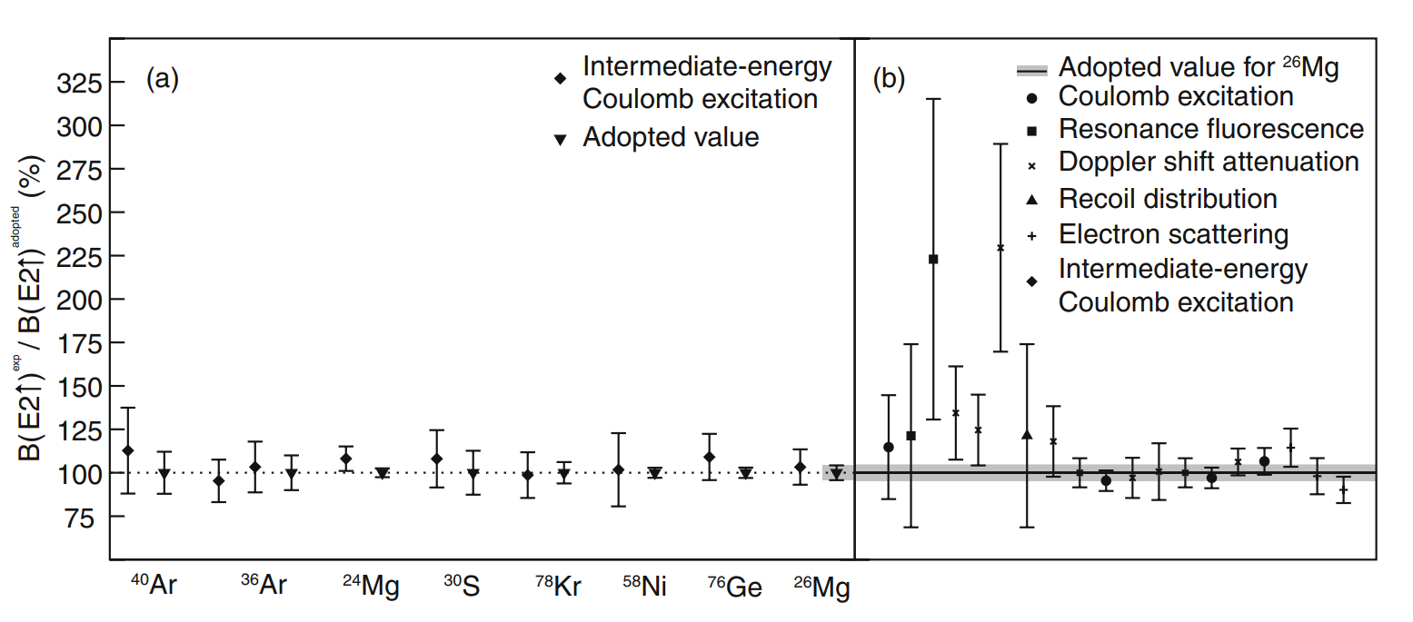
Technique accuracy
Int. Energy Coulomb excitation was tested with well known observables
6%
Total measured-adopted
²⁶Mg total measured-adopted
23%
²⁶Mg Coulex measured-adopted
3%
Domenichetti Lorenzo, 19-2-2021, Nuclear Physics
Notes:
Fine to check with projectiles gammas and not targets ones.
In practice, target’s are emitted at rest and do not undergo the same doppler analysis as projectile gamma do! So, better to check known results from the projectile side, as radioactive ions will always be projectiles, not targets

Slide 17
Outlook
Intermediate-energy Coulomb excitation employed at major RIB facilities
Transition rate measurement with beam rates as 3 atoms/s
Next generation γ-ray detectors (AGATA): strong sensitivity increase
Relativistic kinematics and correct treatment of Coulomb trajectories - Improved analysis techniques
Domenichetti Lorenzo, 19-2-2021, Nuclear Physics
Notes:
IoI due to filling of vf7/2 orbital: strongly deformed states

Slide 18
Domenichetti Lorenzo, 19-2-2021, Nuclear Physics

Slide 19
Domenichetti Lorenzo, 19-2-2021, Nuclear Physics

Slide 20
Domenichetti Lorenzo, 19-2-2021, Nuclear Physics

Slide 21
Domenichetti Lorenzo, 19-2-2021, Nuclear Physics

Slide 22
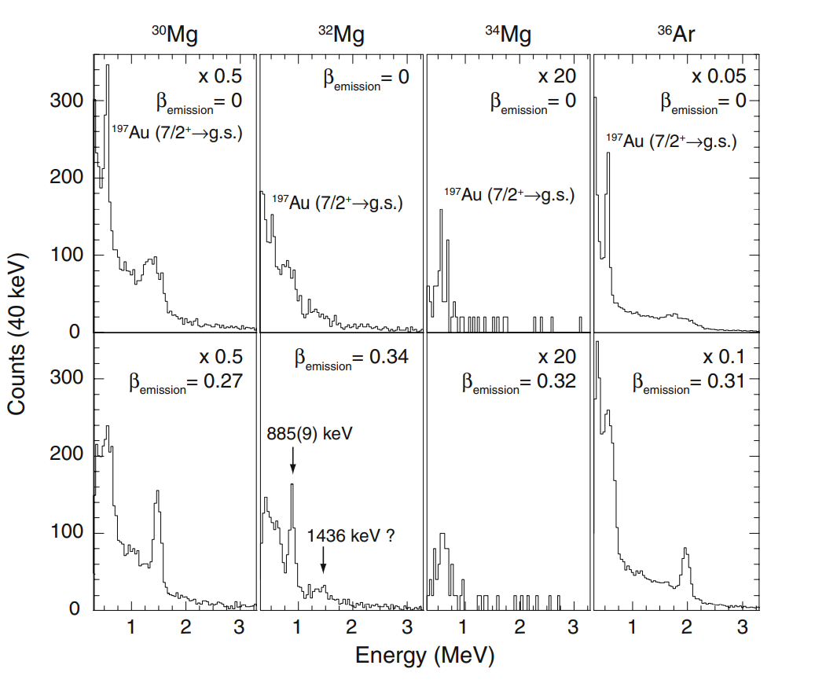


^{30,32,34}Mg Island of inversion
Ground state configurations of ³²⁻³⁴Mg dominated by intruder configurations: IoI
Large measured B(E${2,0}_{g.s.}^{+}→2_{1}^{+}$) in ³²Mg successfully explained by shell model calculations (RIKEN)
Measurement @MSU: possible feeding into $2_{}^{+}$ via 1,426keV γ-ray*. Observerd or not?
Such γ-ray was observed also in $β$-decay studies of 32Na, an other IoI nucleus
Domenichetti Lorenzo, 19-2-2021, Nuclear Physics
Notes:
IoI due to filling of vf7/2 orbital: strongly deformed states

Slide 23
(da tagliare)Why do we need new experimental techniques?
Nowadays, there is a large availability of RIBs in dedicated facilities.
The main issue is related to the beam rate, at is usually decreases by orders of magnitude only adding a nucleon far from stability.
.. And of course, increasing the beam time by orders of magnitude is not a feasible opportunity!
Thus, new experimental techniques have to be developed.
The one that will work with the lowest beam rates will have the furthers scientific reach
Domenichetti Lorenzo, 19-2-2021, Nuclear Physics
Notes:
Production of beams far from stability decreases by orders of magnitude with farer nuclei from stability. And we can not increase the experiment beam time by orders of magnitude!

Slide 24
Domenichetti Lorenzo, 19-2-2021, Nuclear Physics

